Slide 1

SocketBurners
Aashir MRM
220004M
Muftee MMM
220399B
Munavvar MAA
220405T
Nadha MI
220409J
EcoSync
“Enhancing Comfort, Conserving Power, Innovating the Future”
Intelligent AC Temperature Regulator
EN1190 – Engineering Design Project

Slide 2



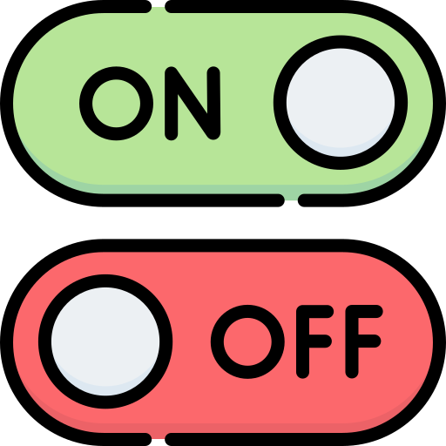
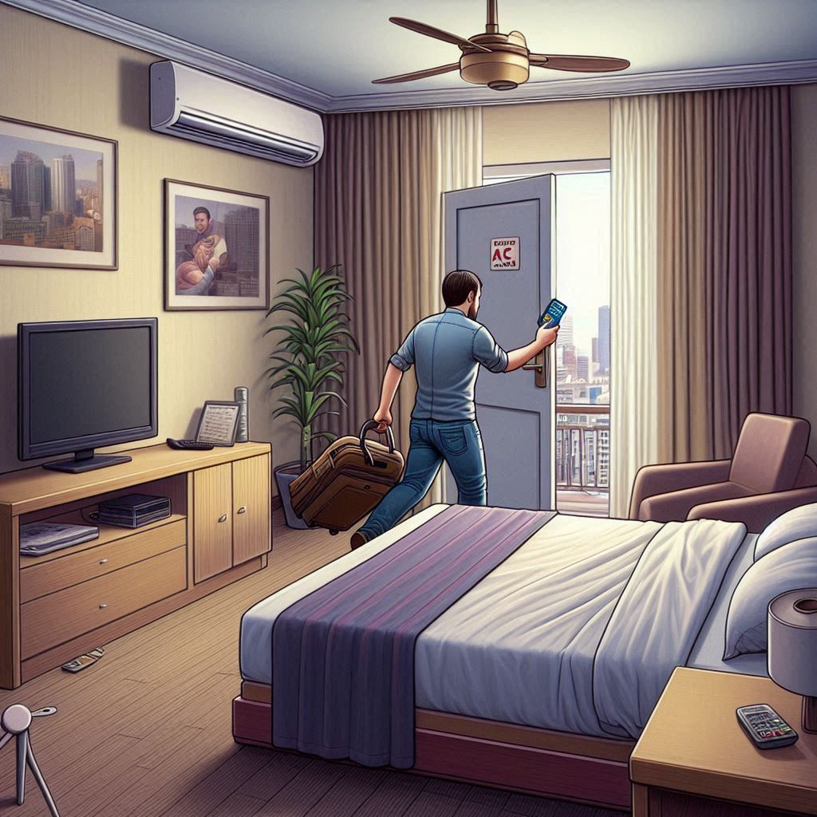

The Problem
“Energy Wastage due to lack of optimization in luxurious hotels.”
Cut the power
to the room while
Keeping the AC running
1
User leaves
the hotel room with
the keycard
Waste of Energy
Cut the entire
power supply
2
User discomfort
upon arrival

Slide 3
The Solution
The Beneficiary
A compromise between visitor comfort and energy usage is required.
To accomplish this, we present to you
Luxurious Hotel chains
&
The people of Sri Lanka
EcoSync
“Enhancing Comfort, Conserving Power, Innovating the Future”
Intelligent AC Temperature Regulator
ECOSYNC regulates the air conditioning system based on user presence.

Slide 4

Designing the Solution
The Concept
Breadboard Implementation
PCB Design
Enclosure Design
Assembly

Slide 5
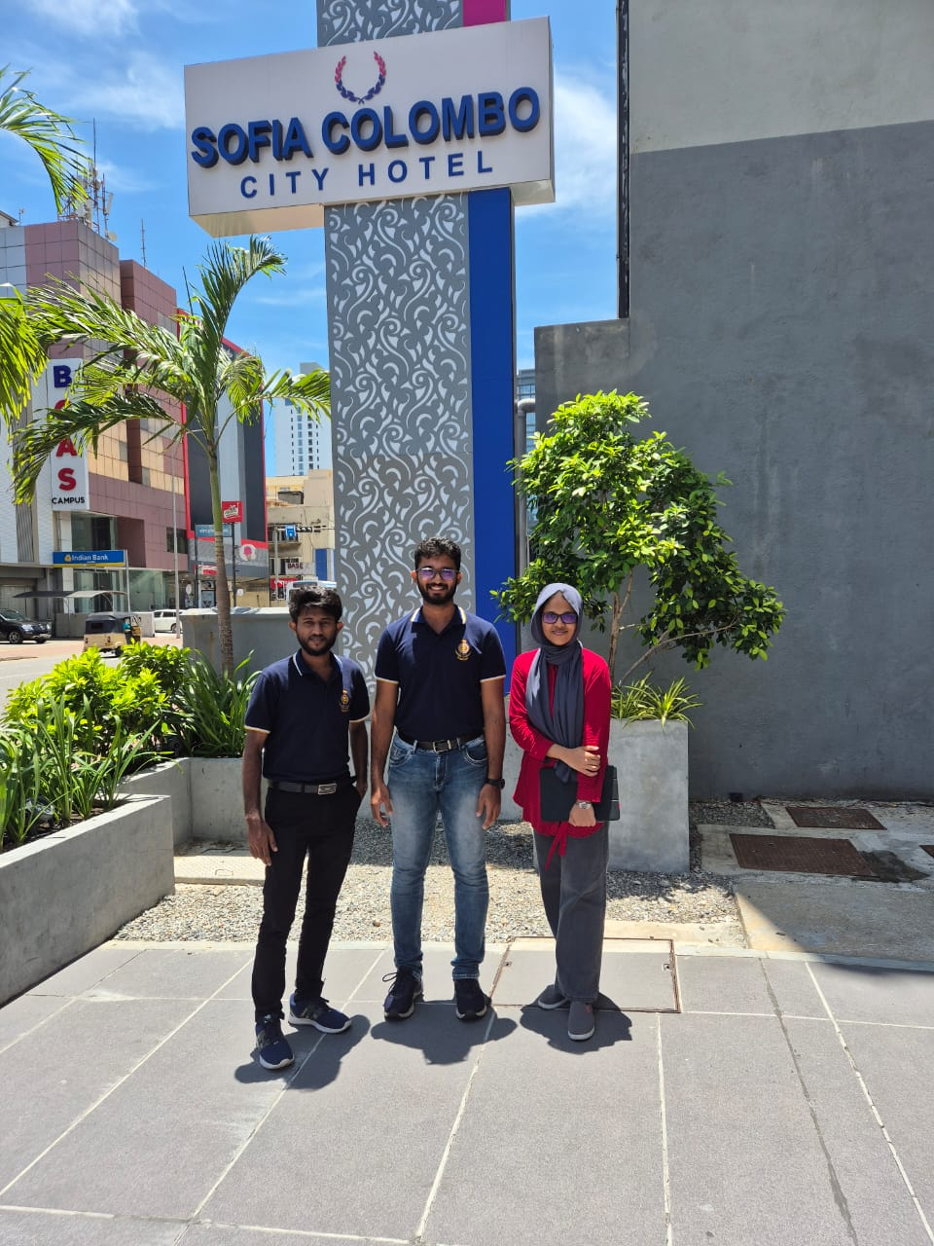
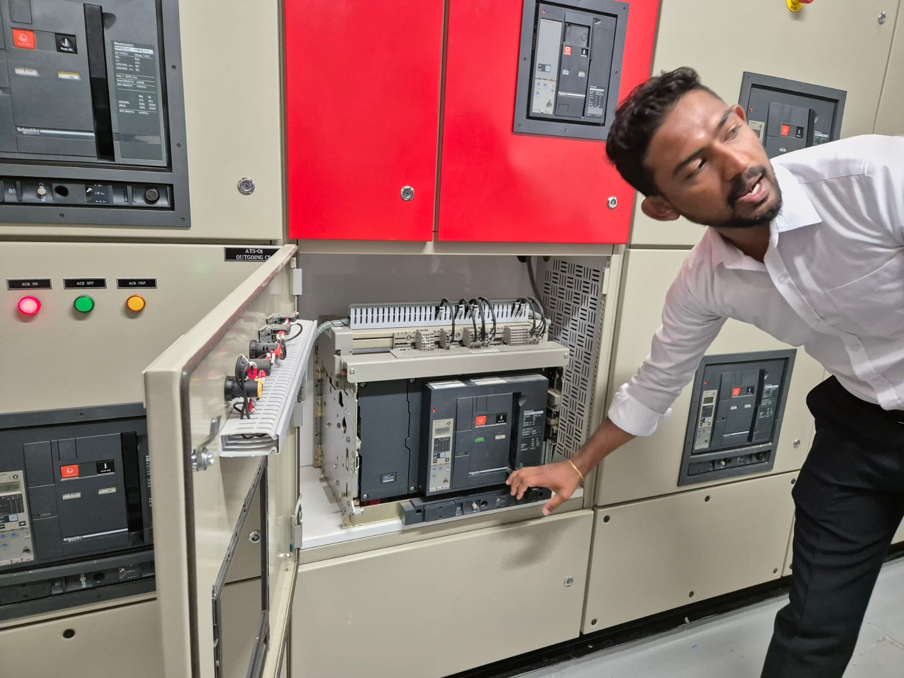
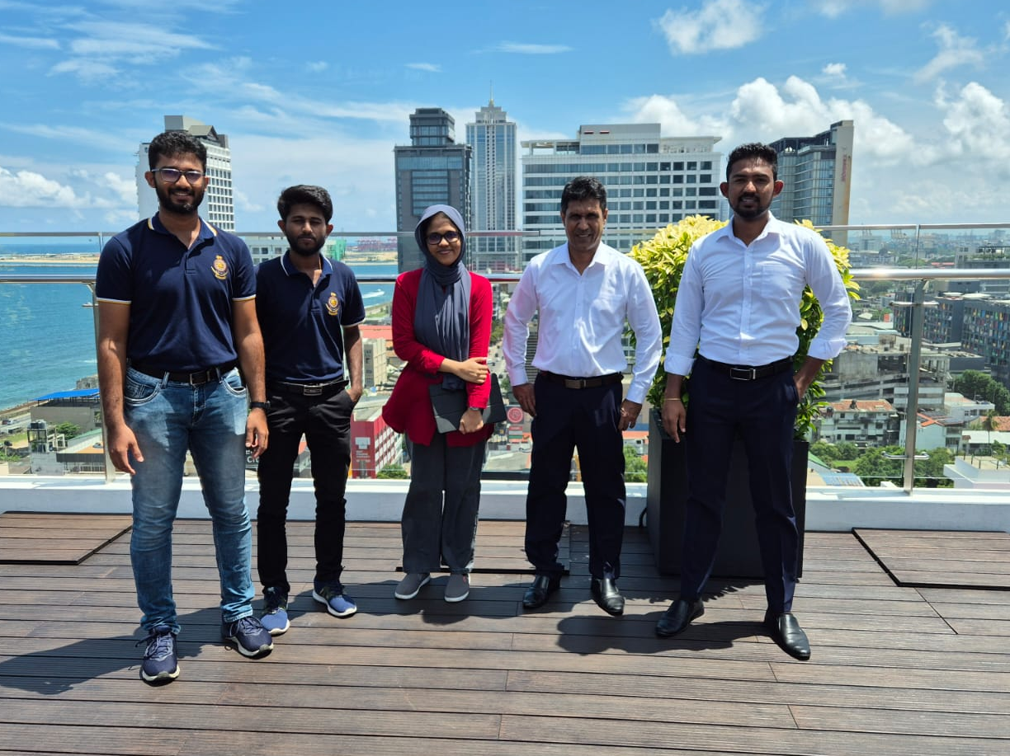
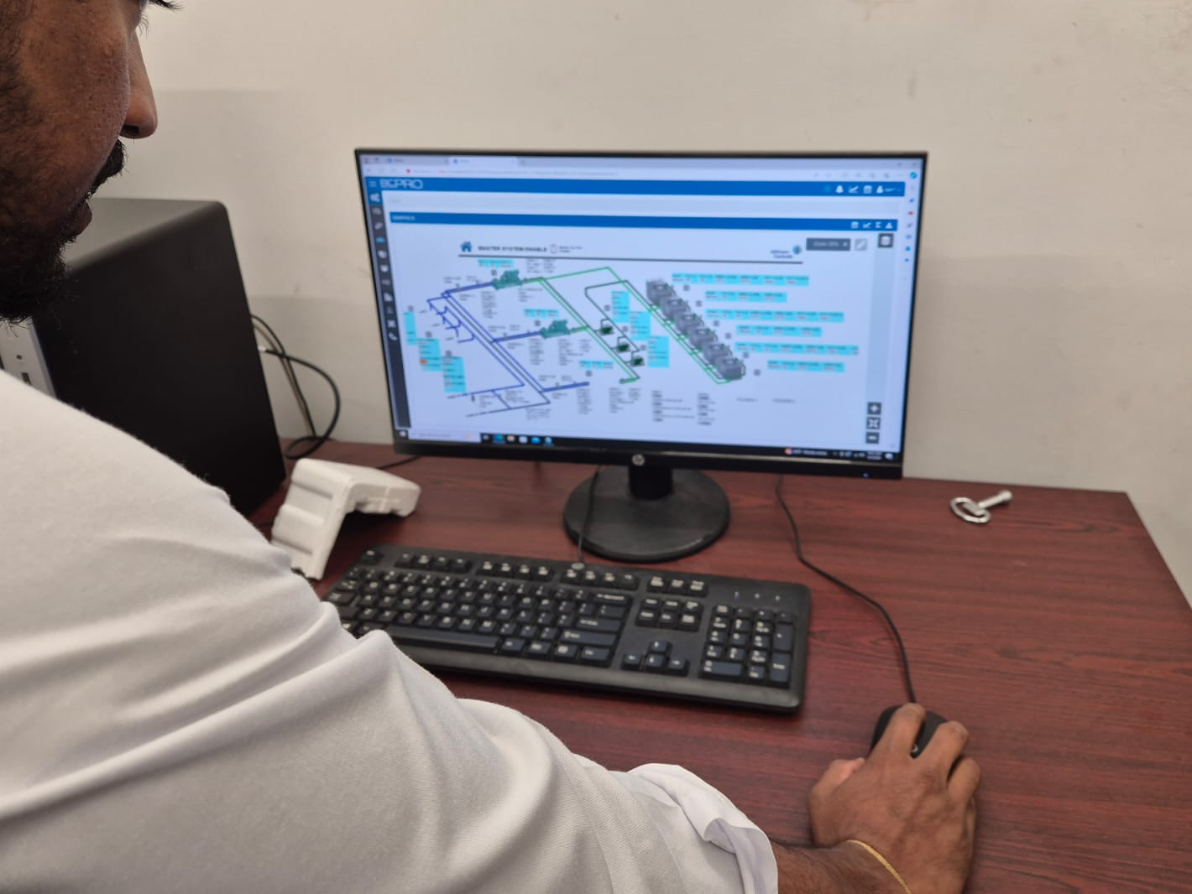
Problem Validation
Hotel Visit: Sofia Colombo

Slide 6
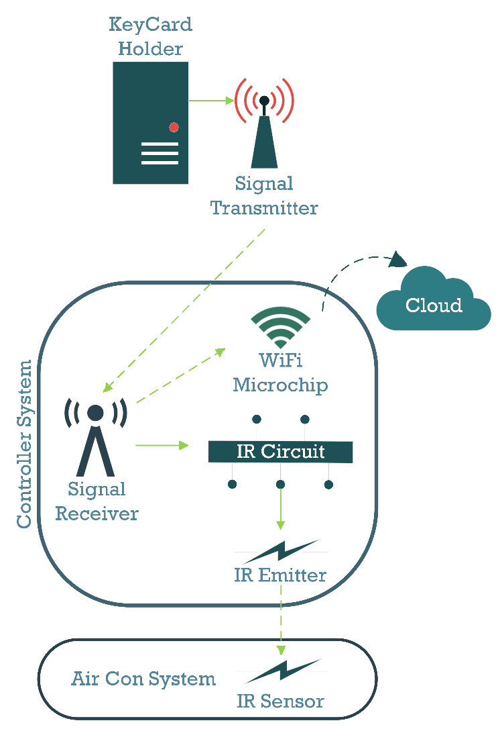
Block Diagram of the Concept

Slide 7









Functionality
ECOSYNC is a combination of two separate units
KPD: Keycard Presence Detector
ACC: Air Conditioner Controller
When the Keycard is removed, (Person Left the room)
The relevant IR signals are sent to the AC
KPD
Eco Mode: Temperature rises to 25°C
Luxury Mode: Temperature rises to 23°C
The message gets transmitted to ACC through Bluetooth
The ACC receives the message
ACC
Preset by hotel management

Slide 8
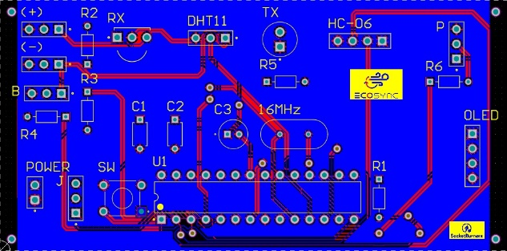
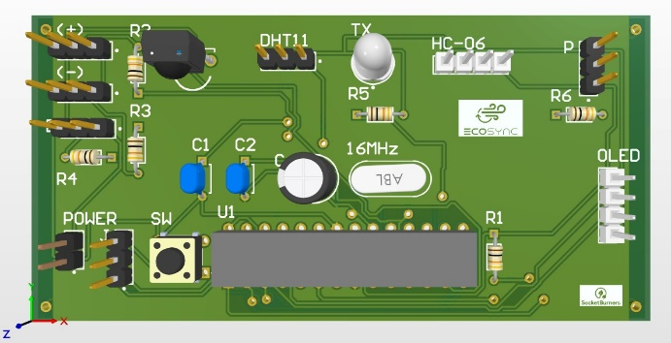
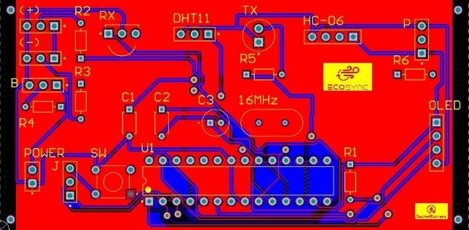
The PCB Design
ACC

Slide 9
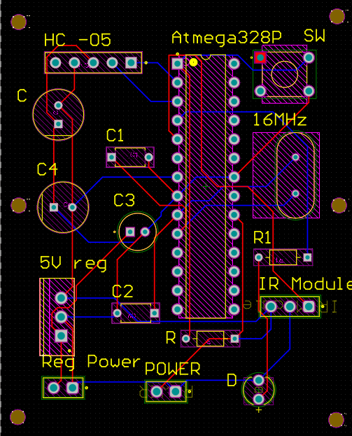
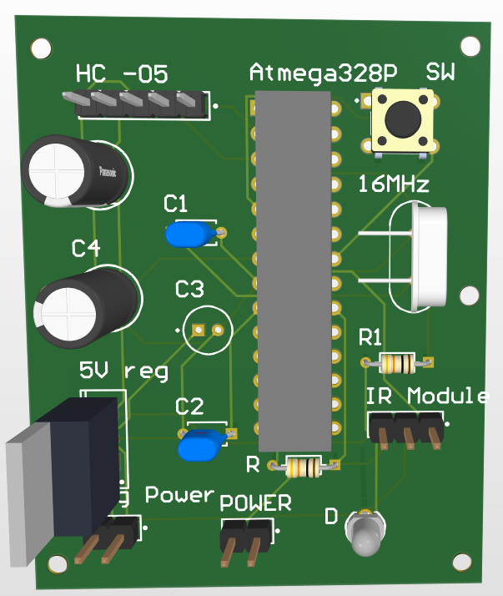
The PCB Design
KPD

Slide 10
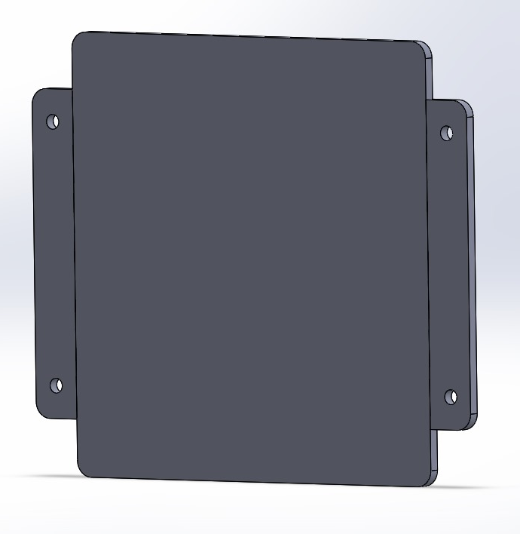
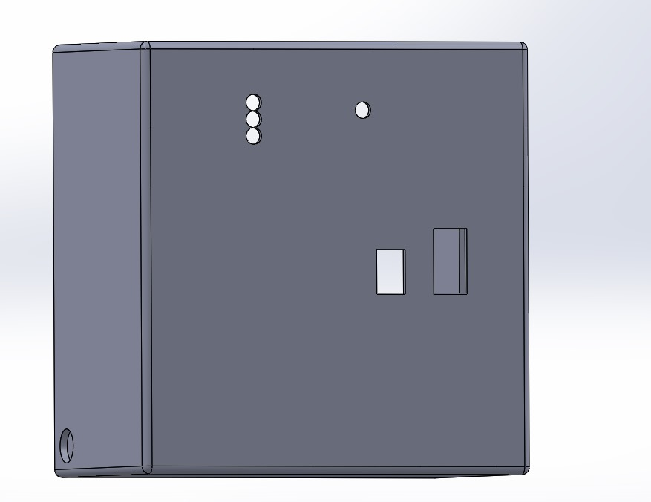
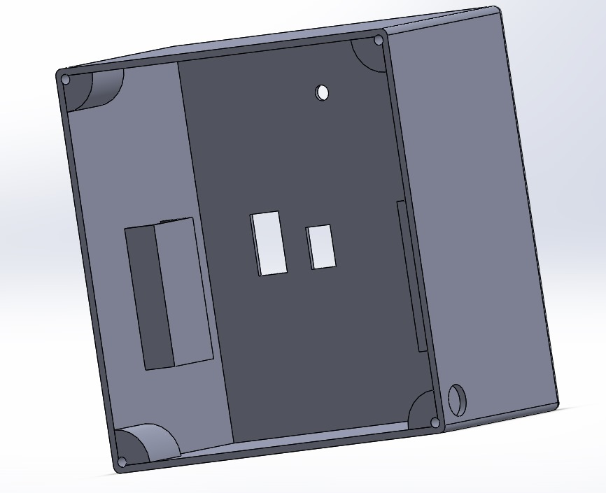
The Enclosure Design
ACC

Slide 11
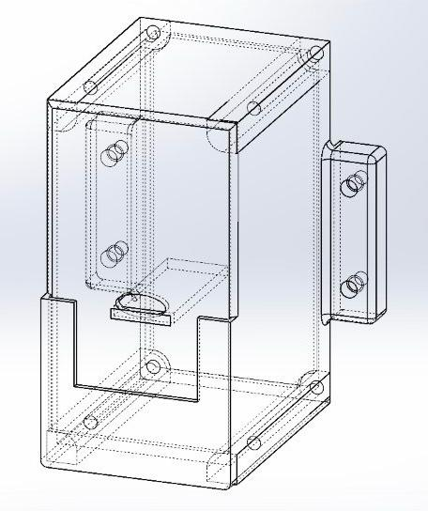
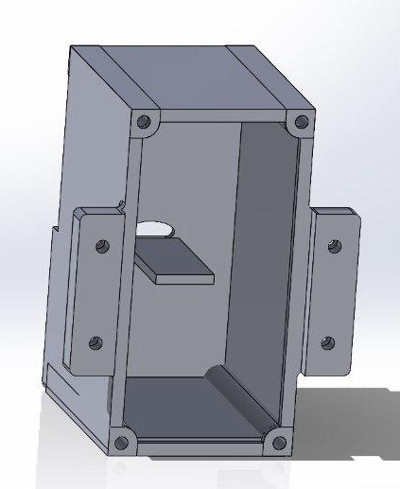
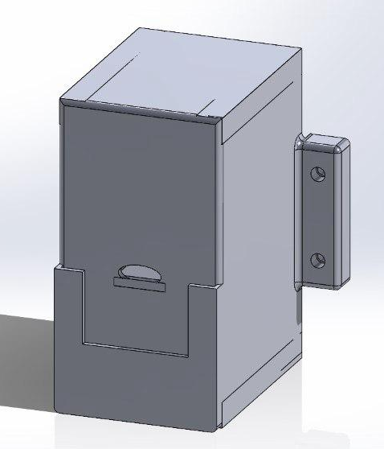
The Enclosure Design
KPD

Slide 12
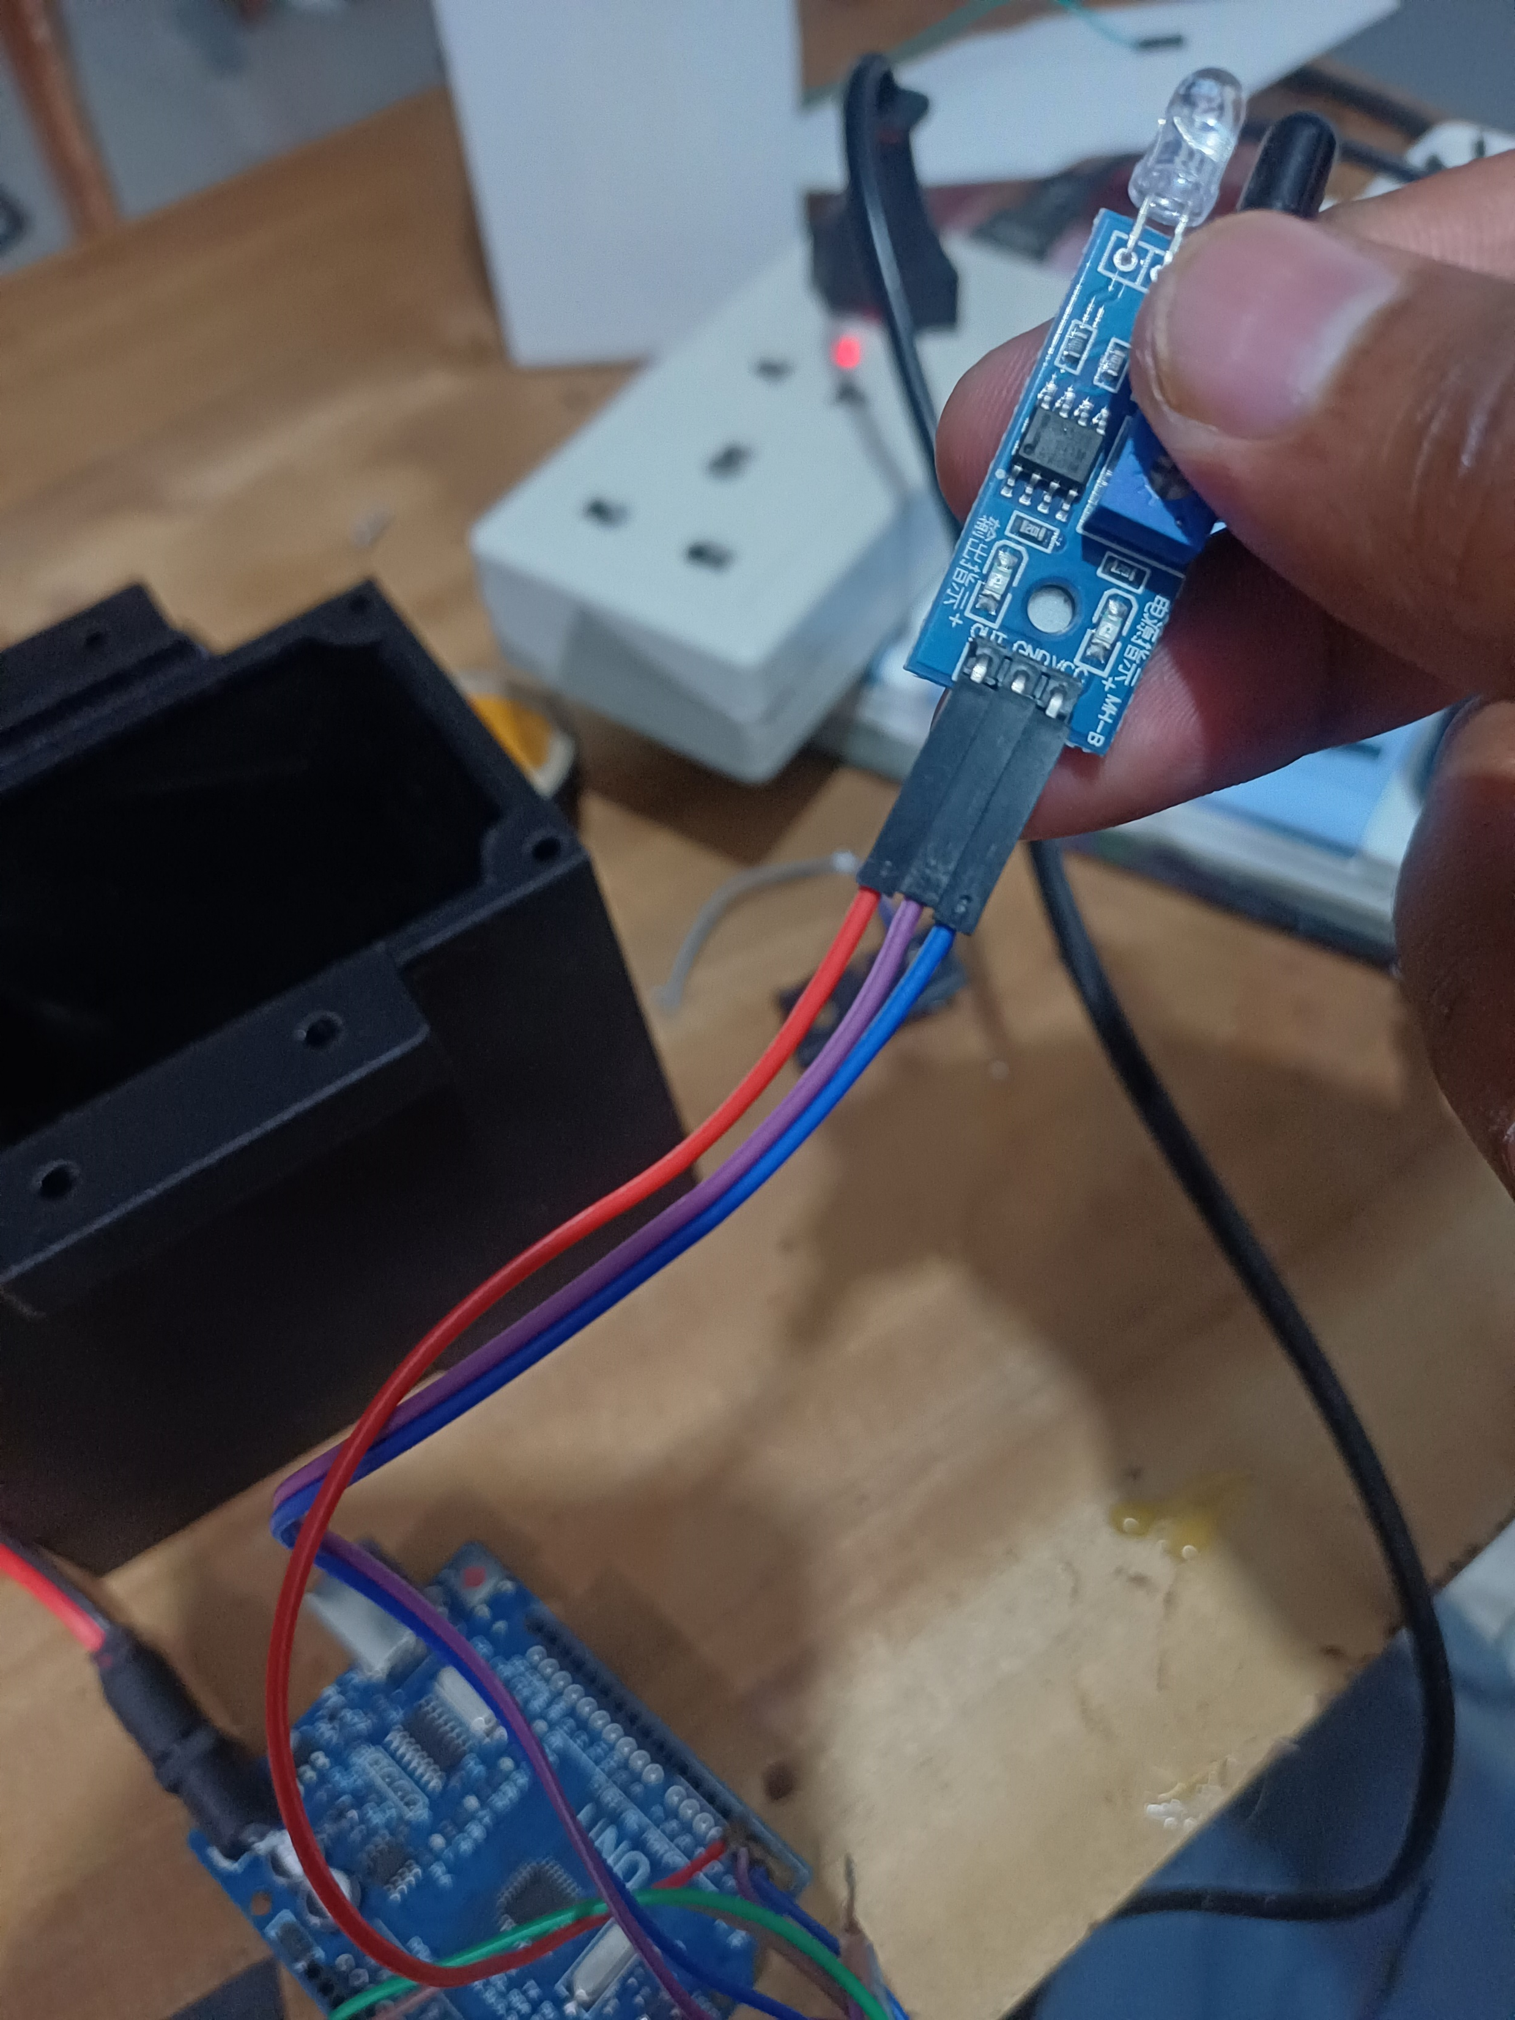
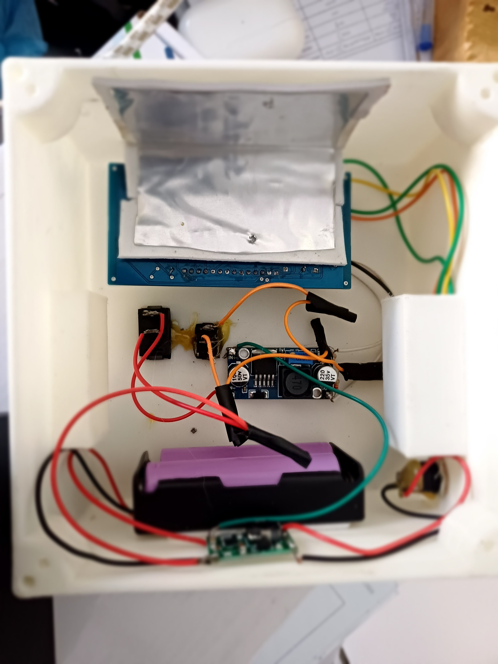
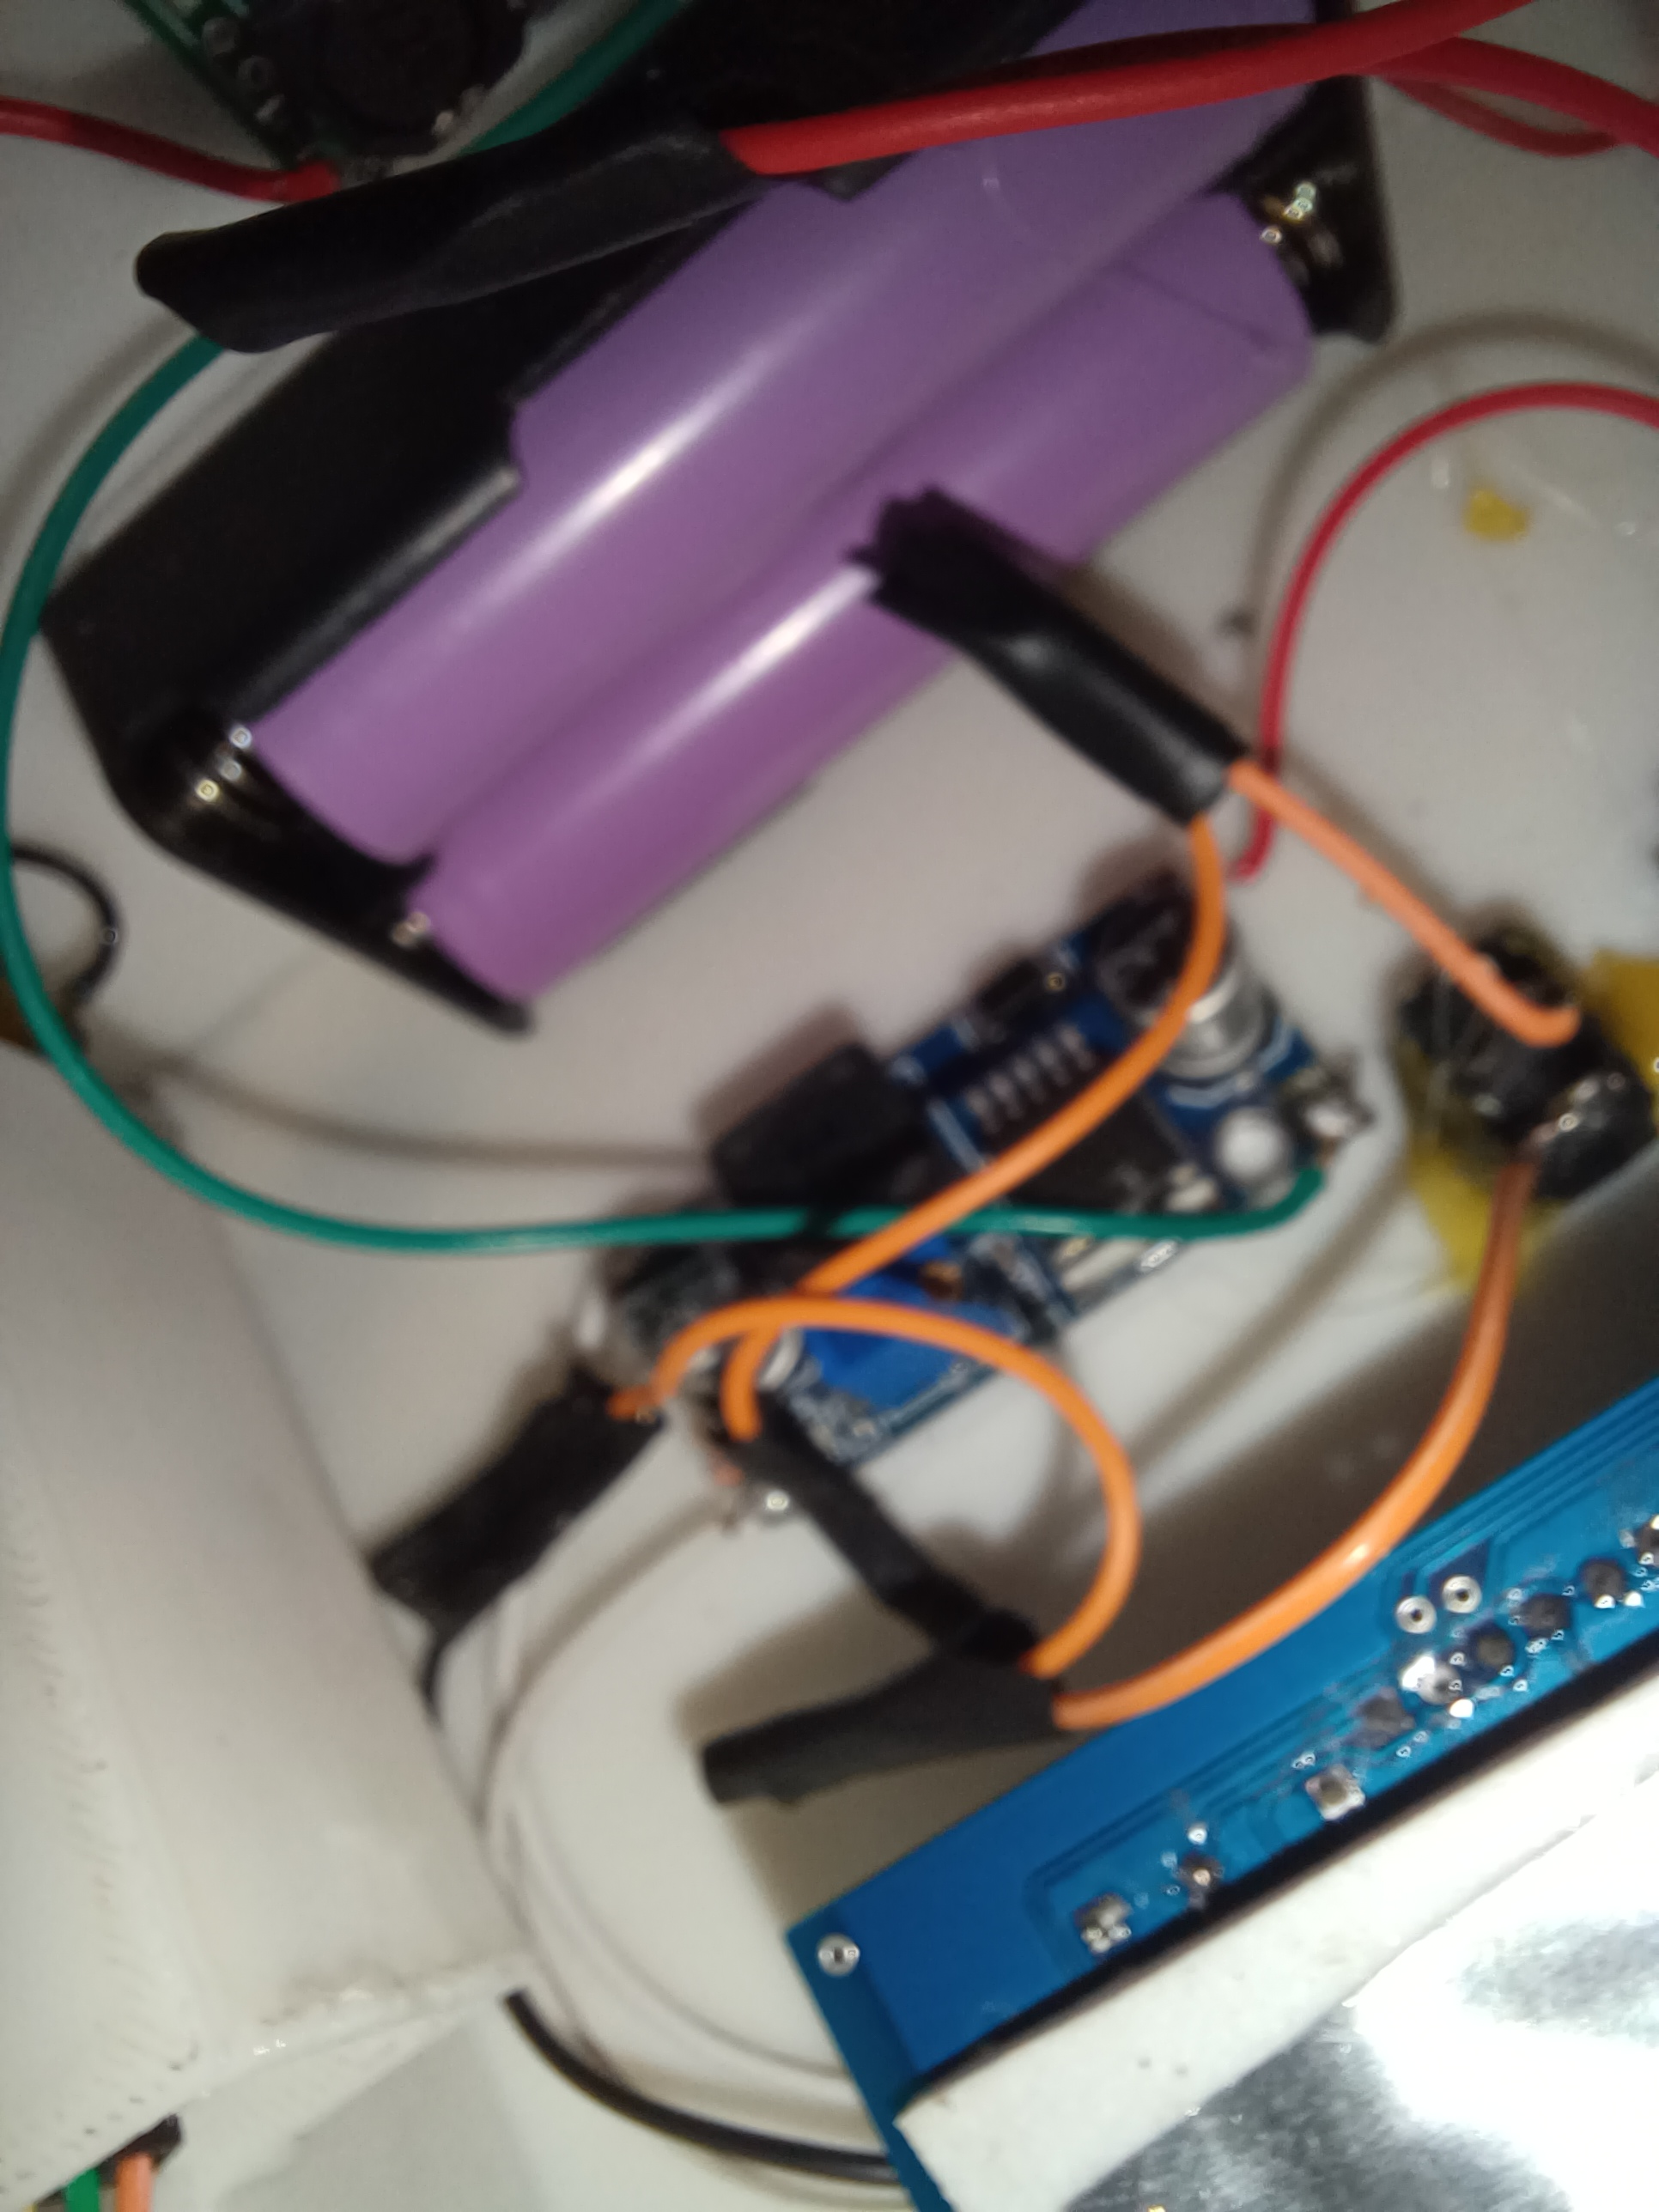
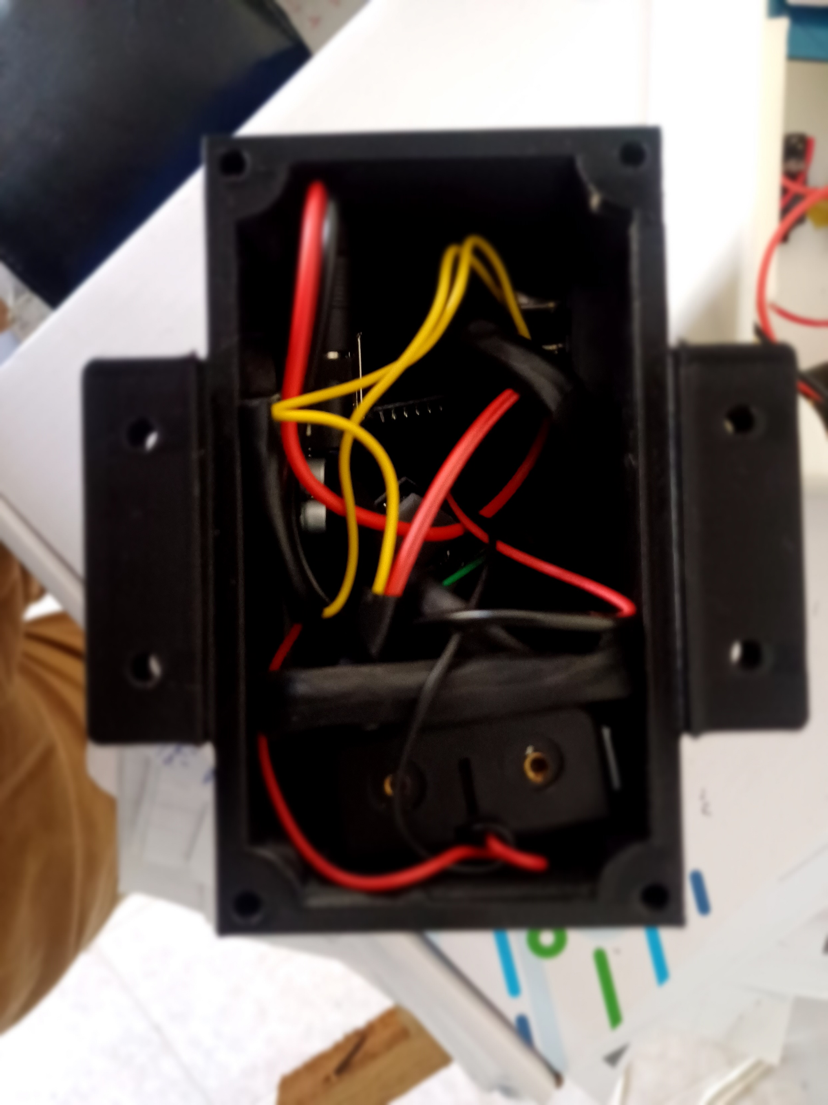
The Assembly

Slide 13
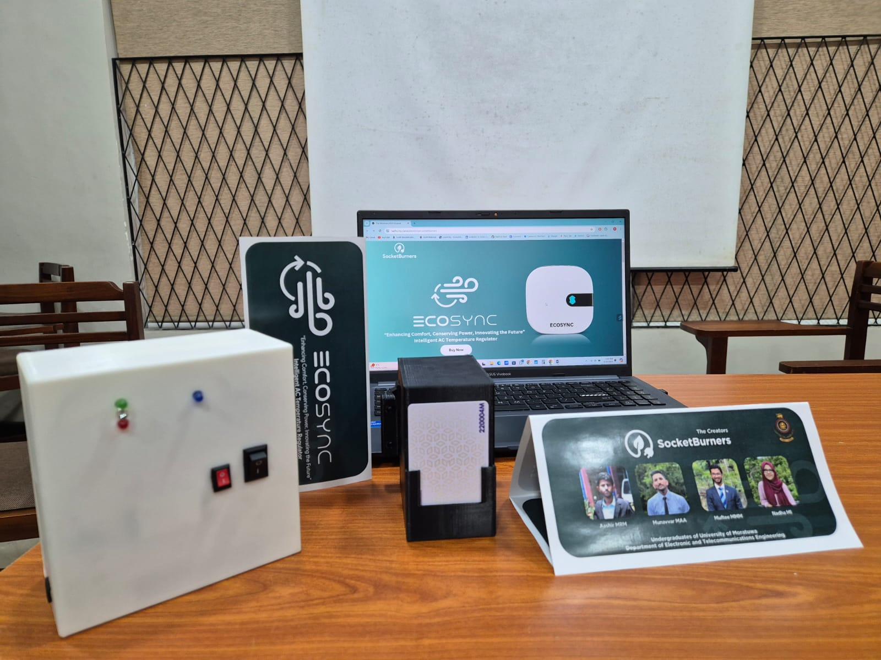
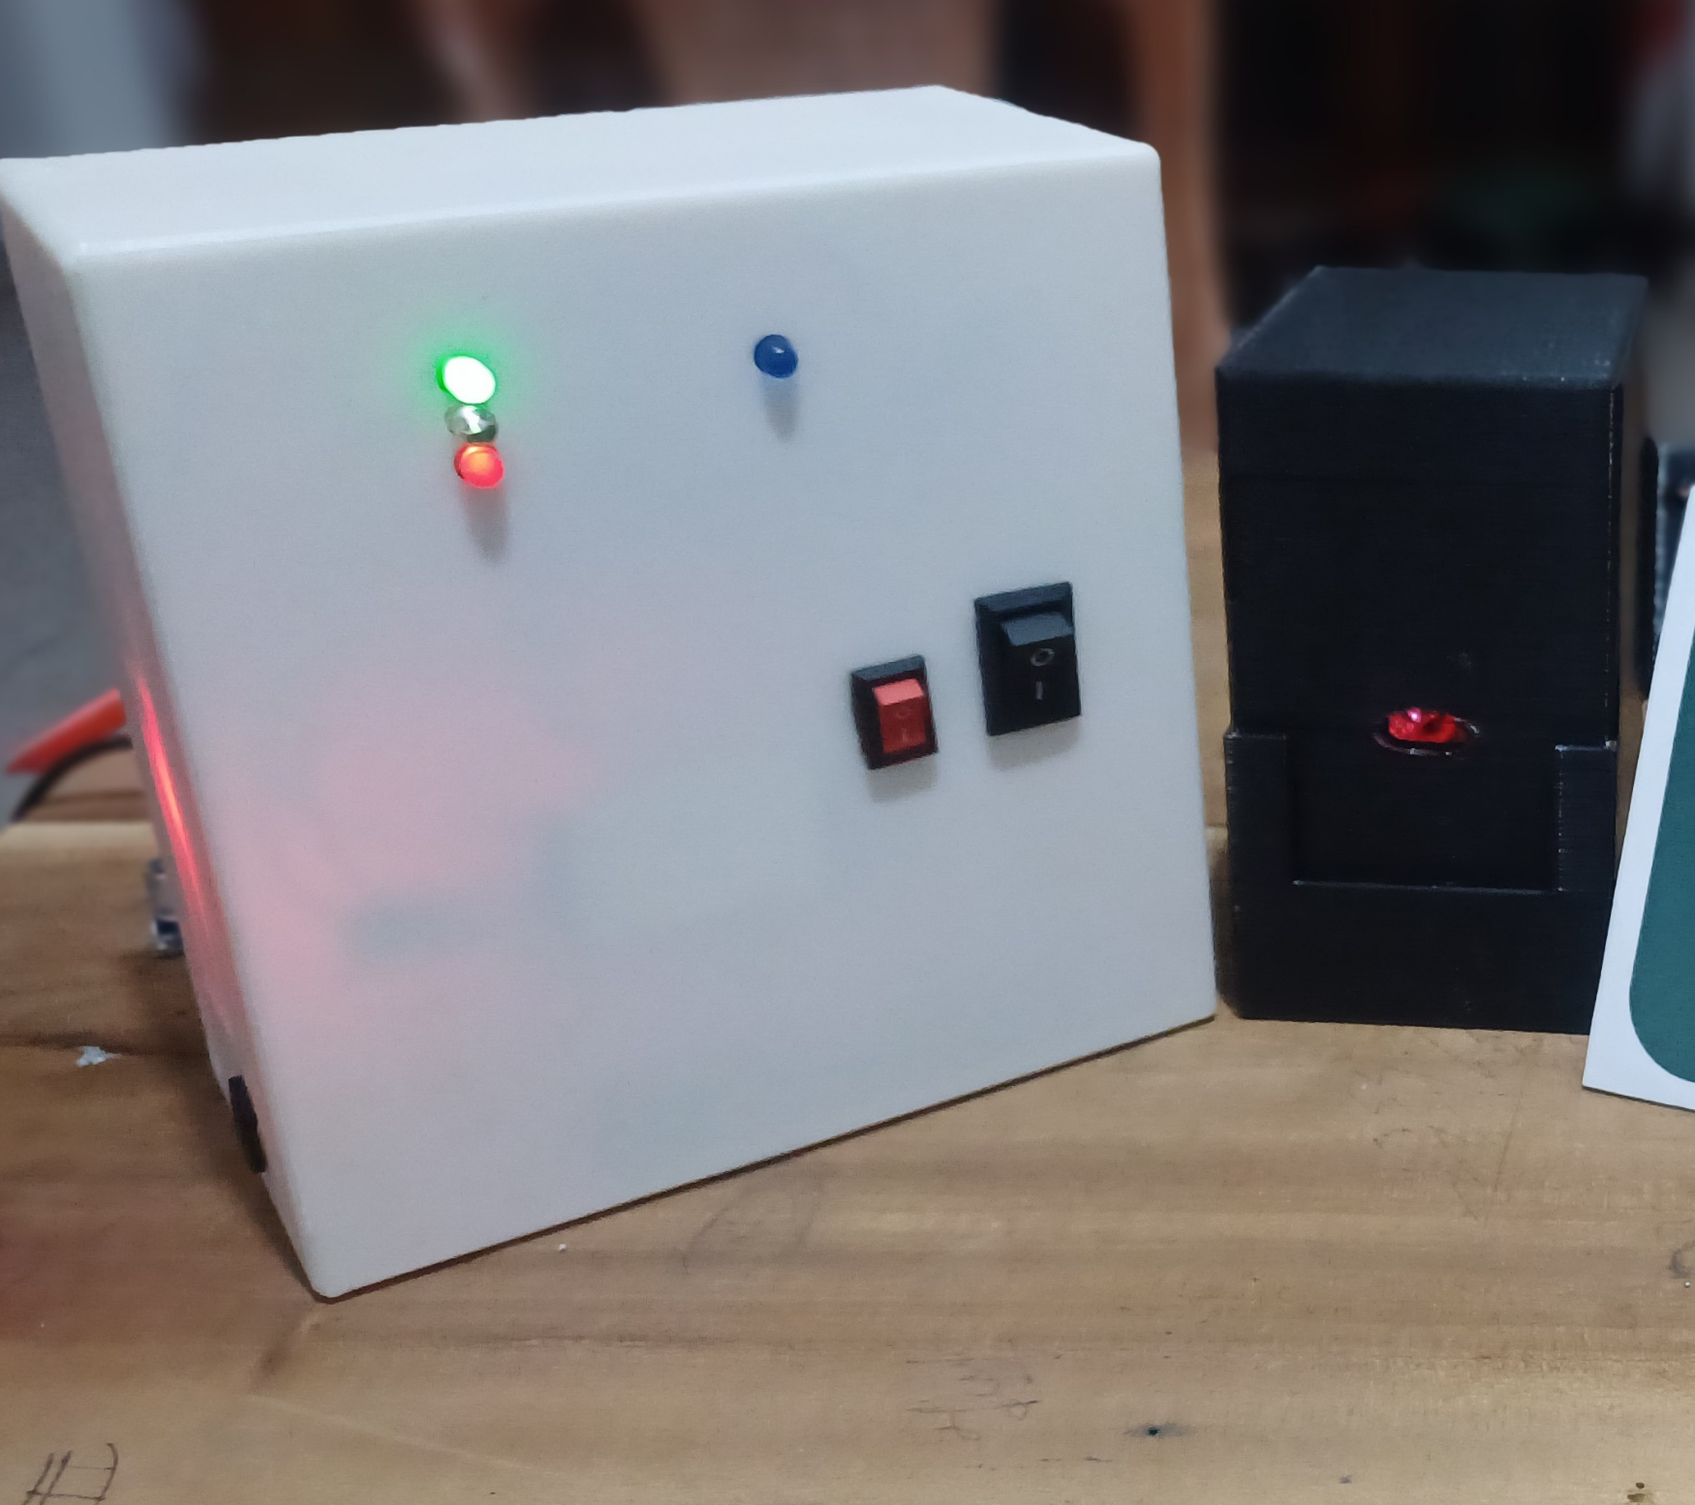
The Final Product

Slide 14


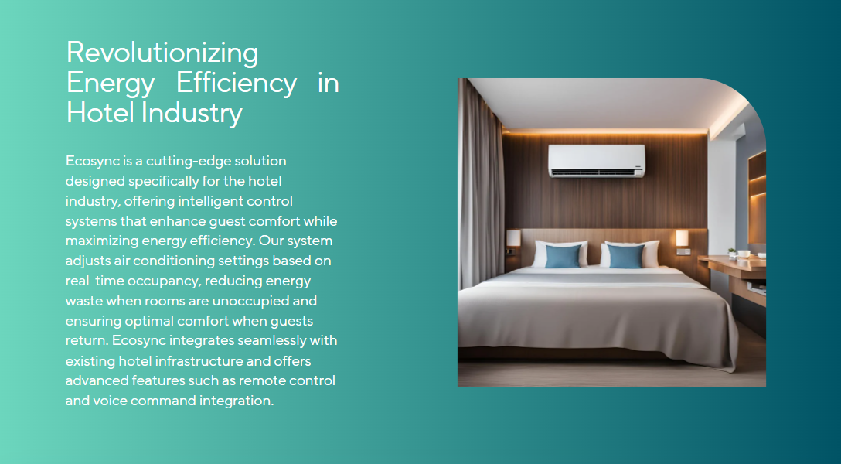

Our Website

Slide 15
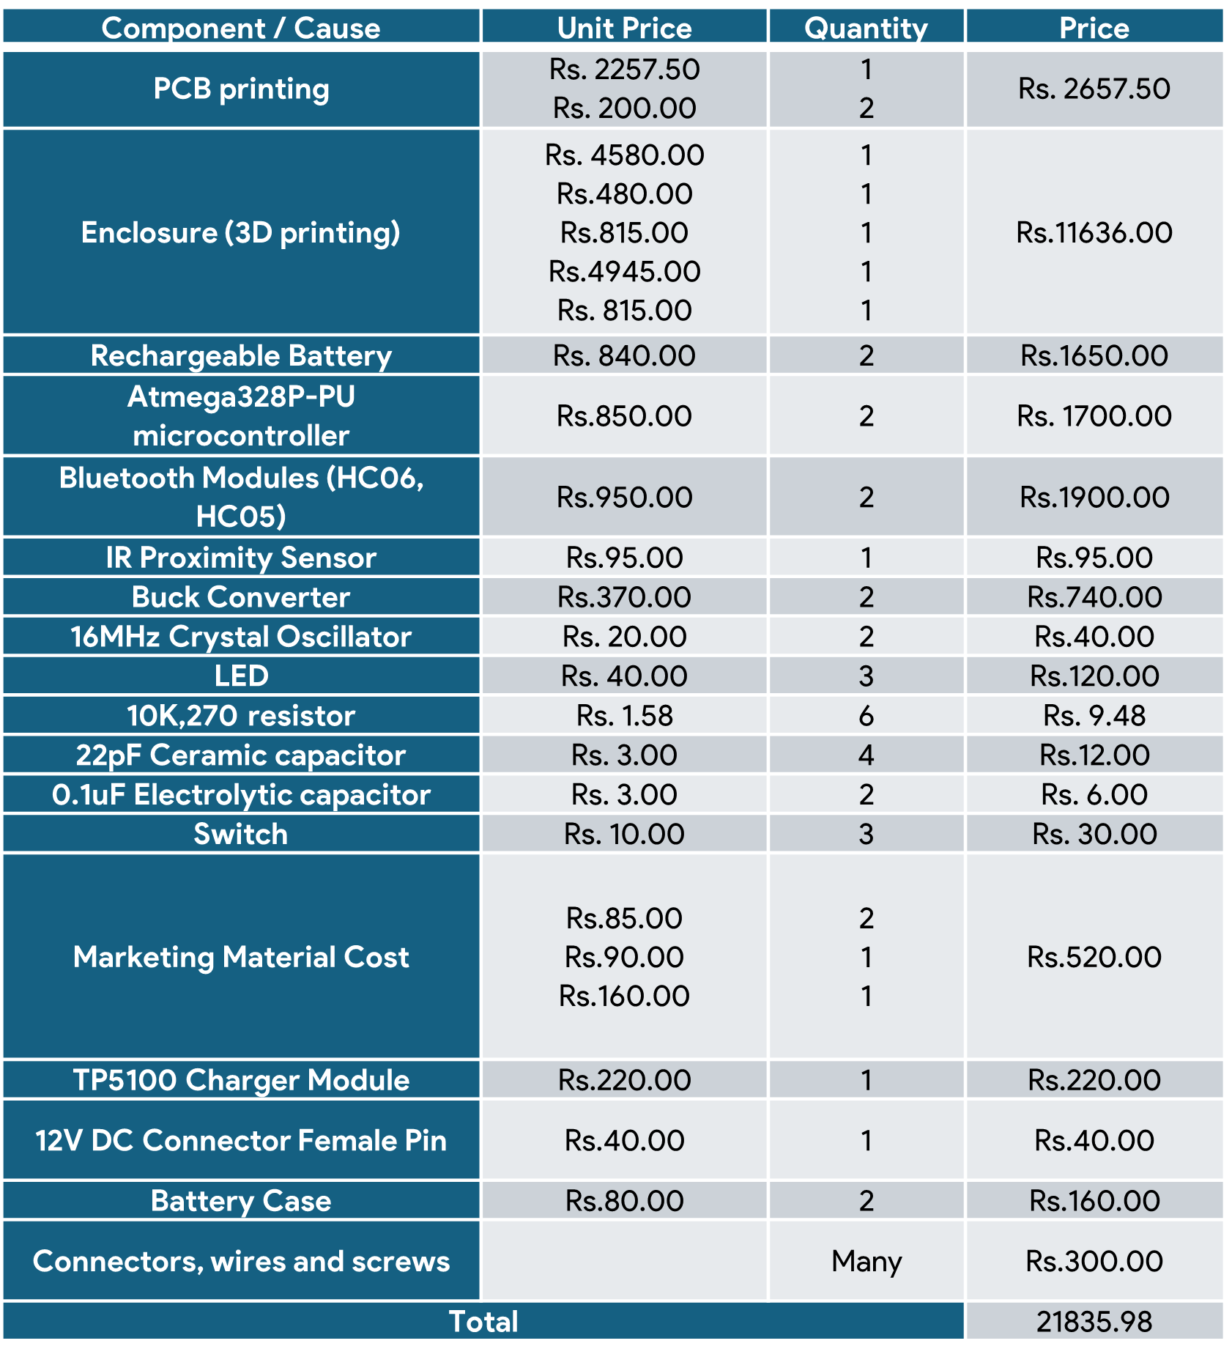
Project Budget
Rs.21835.98

Slide 16
Task Delegation
TASK | ALLOCATED MEMBER(S)
Finding a problem | ALL
Solution plan | ALL
Circuit Diagrams | Muftee MMM Aashir MRM
PCB design | Nadha MI
Programming and coding the controller | Aashir MRM
Enclosure design | Muftee MMM
Product assembly | Aashir MRM Munavvar MAA
Documentation Preparations | Munavvar MAA Nadha MI
Brand design | Munavvar MAA
Web Page Design | Nadha MI

Slide 17
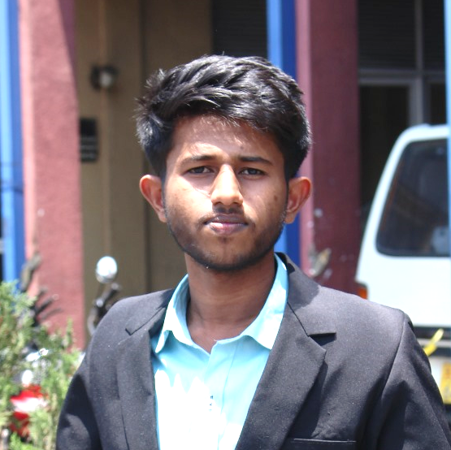

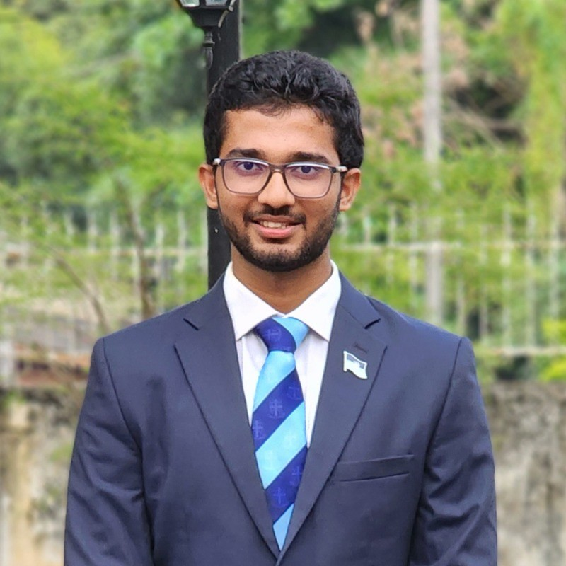

The Team
SocketBurners
Aashir MRM
220004M
Munavvar MAA
220405T
Muftee MMM
220399B
Nadha MI
220409J

